Slide 1
Training Template Company Sexual Harassment Policy & Procedures Overview
Created January 2025
This template is a slide deck designed to give an overview of Sexual Harassment Policy & Procedures. It’s ideal for smaller businesses getting started in their processes and training.

Slide 2
Agenda
What is sexual harassment?
What is our duty as employers?
How can we assess the risk of sexual harassment in context of our workplace?
How can you report incidents of sexual harassment?
How can we ensure ongoing monitoring and prevention?

Slide 3
What is sexual harassment?
Unwanted conduct of a sexual nature that has the purpose or effect of violating a person’s dignity or creating an offensive, intimidating or hostile environment for them.
Of a sexual nature, but does not have to be sexually motivated.
Doesn’t have to be directed at anyone in particular.
Conduct invited or welcomed in the past can be unwanted.
Could be a one-off.

Slide 4
Sexual harassment could include
Sexual comments or jokes
Displaying images
Suggestive looks, staring, leering
Propositions or sexual advances
Making promises for sexual favours
Sexual gestures
Intrusive questions about private or sex life
Sexual posts or content on social media
Spreading sexual rumours about someone
Unwelcome touching

Slide 5
Our duty as employers
New positive duty to prevent sexual harassment
Aims to transform workplace cultures
Required to anticipate scenarios and take action to prevent (risk assessment)
Act to prevent it happening again
Take into account 3rd party harassment
1
2
3
Take ‘reasonable steps’ (the preventative duty)
What is ‘reasonable’ varies by company/business
Preventative duty is anticipatory and ongoing
Equality and Human Rights Commission has the power to enforce
Employees are able to report and be compensated
4
5
6

Slide 6
Action Plan
Establish our anti-harassment policy
Engage staff
Training at induction.
One-to-one meetings at any point, leadership open door policy.
Exit interviews.
Assess and reduce risk
Establish a reporting mechanism
Conduct staff training
Establish the complaint handling procedure
Communicate processed to our third parties
Monitor and evaluate

Slide 7
When are situations risky?
Consumption of alcohol: moderation reminders; no one should feel pressure to drink.
Interaction with 3rd parties: attend meetings with a colleague if uncomfortable going alone; send code of conduct polices as part of our account forms and T&Cs.
Social situations: ensure you know the signs of sexual harassment and know how to act; designated person at work events who can discreetly support anyone who feels unsafe, uncomfortable, or who may have had too much to drink.
Late nights: always take the safe option home, speak to leadership if you have any concerns about getting home safely.
Personal interactions: check the dynamics of the relationship, is there an unbalance (e.g., can someone exercise control over someone else?).

Slide 8
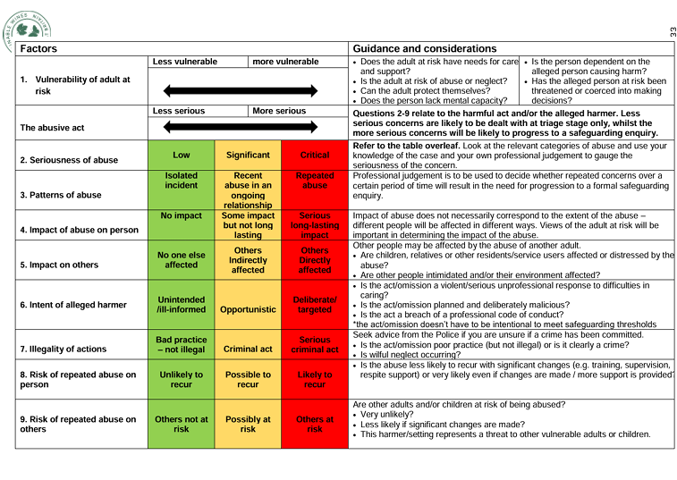
Risk assessment (Example from the WineGB Safeguarding Toolkit)

Slide 9
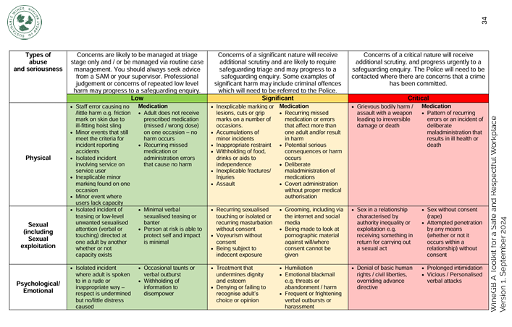
Risk assessment (Example from the WineGB Safeguarding Toolkit)

Slide 10
Reporting incidents of sexual harassment
How you can report an incident
How to issue an informal or formal complaint.
Process for formal complaints.
Mark emails as sensitive/private:
https://support.microsoft.com/en-gb/office/mark-your-email-as-normal-personal-private-or-confidential-4a76d05b-6c29-4a0d-9096-71784a6b12c1

Slide 11
Ongoing monitoring and prevention
Induction
Training and agreement with policies and procedures during new employee induction
Staff 1-to-1s
Harassment issues can be discussed during any 1-to-1s throughout the year (an ‘open door’ policy)
Exit interviews
Questions regarding harassment policy and procedures will be conducted during exit interviews
Engagement with industry bodies
E.g. Member of Drinks United (WSTA, WSET, Drinks Trust) - drive coordinated DEI and safeguarding action across the UK drinks industry to create a culture that reflects and supports its people.

Slide 12
Questions and Comments

